Slide 1
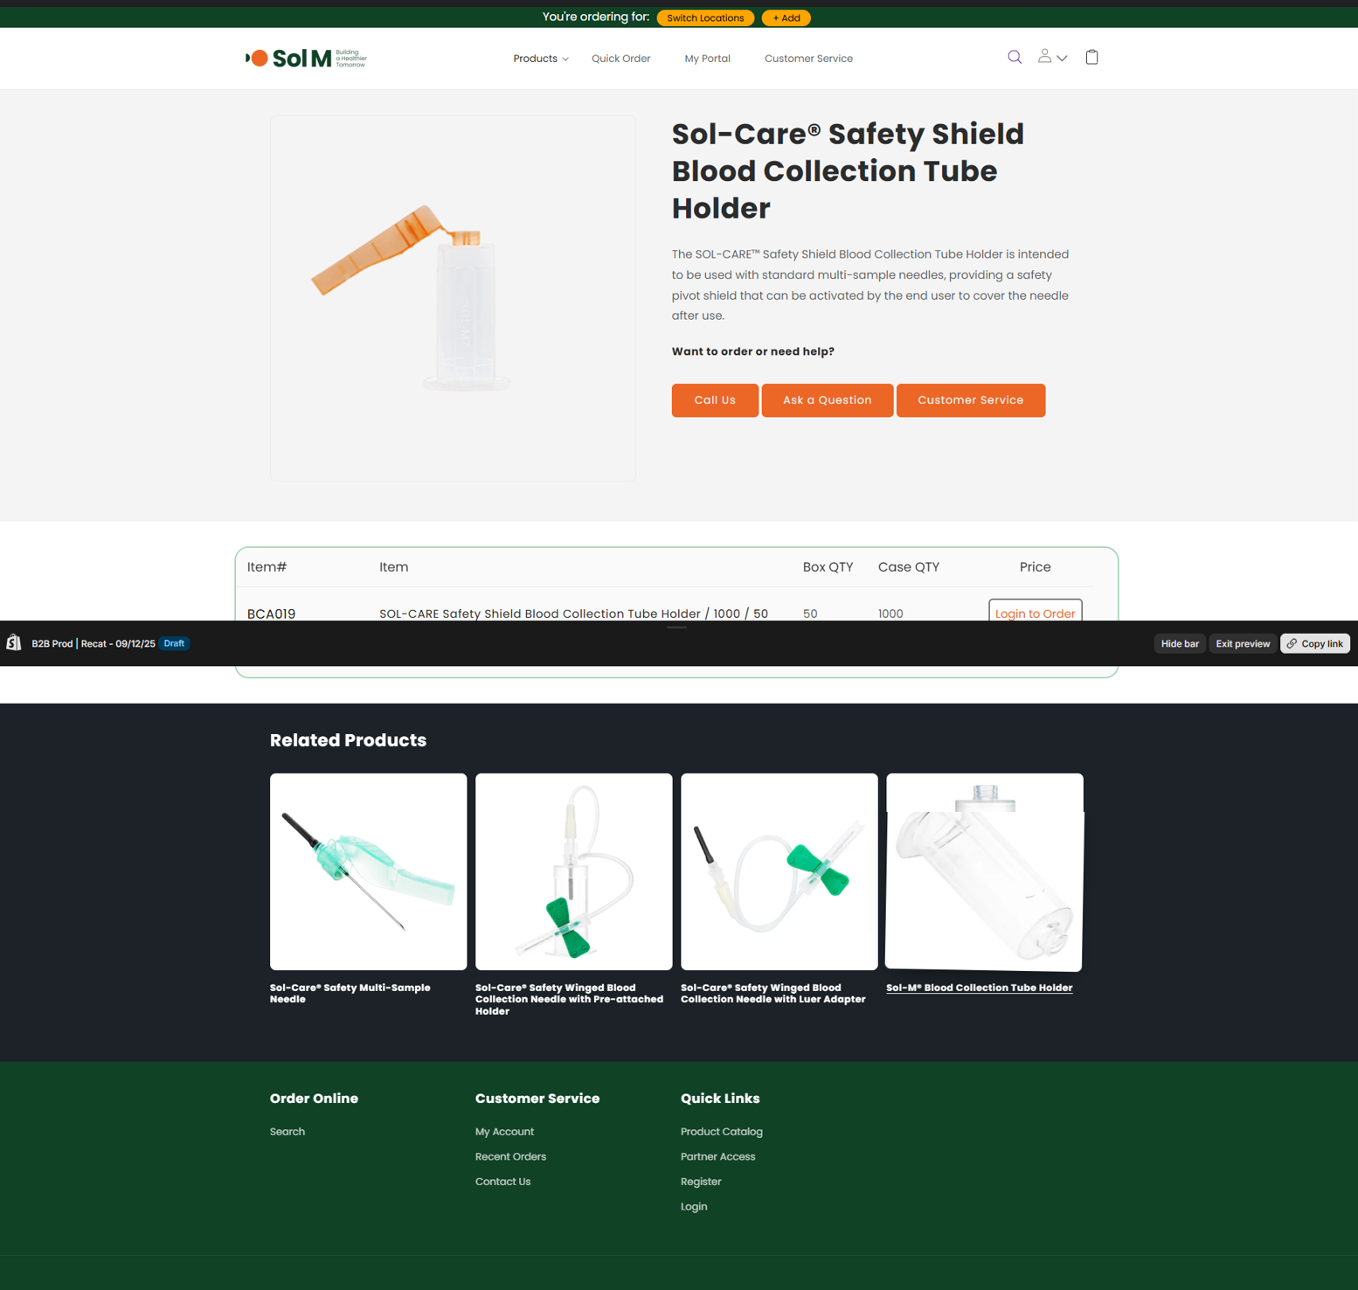
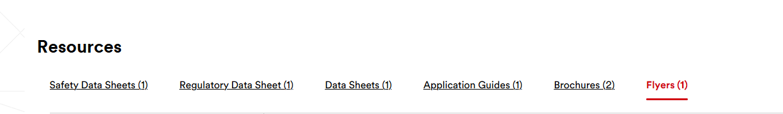
Leads Generation: Valuable content drives calls to action.
Consider adding a "Resources" section on the PDP page with options such as "Request a Free Sample" or "Download e-Catalog" to encourage customers to submit a web form, thereby capturing lead information for follow-up, nurturing, and conversion by inside sales.

Slide 2
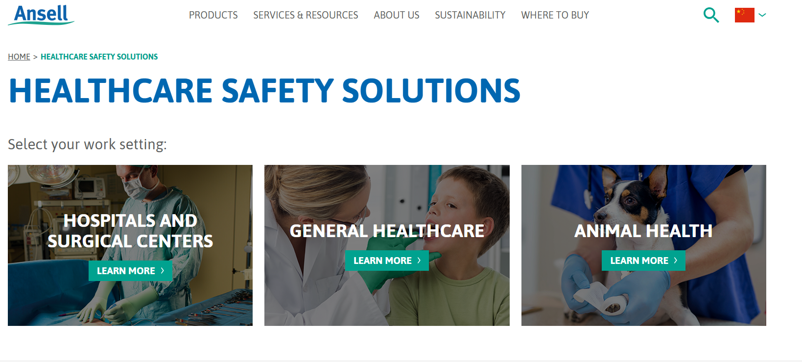
Leads Generation: Considering create a dedicated new Solution Page for the AWC and PPE segments?
This would allow the BU to present an integrated solution perspective to customers, clearly illustrating which industries and specific application scenarios we can serve. The BU could leverage this page for customer outreach and promotion.

Slide 3
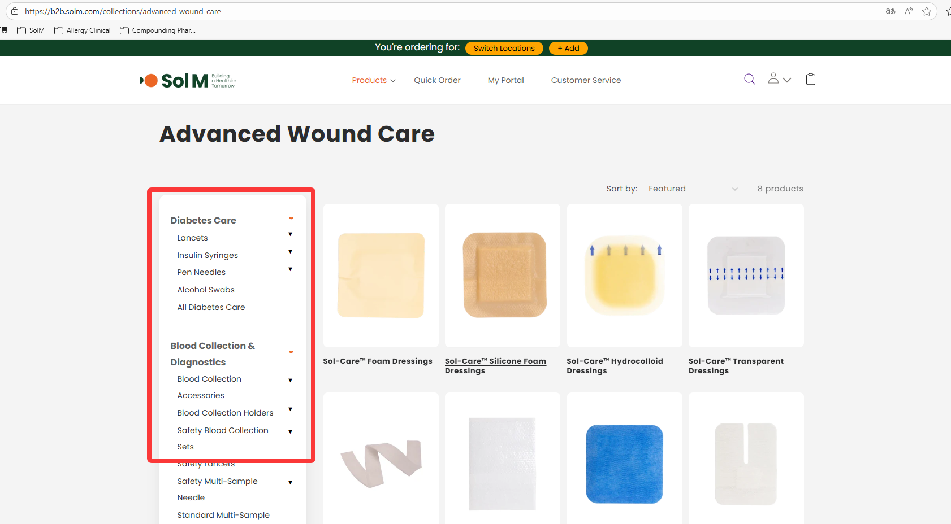
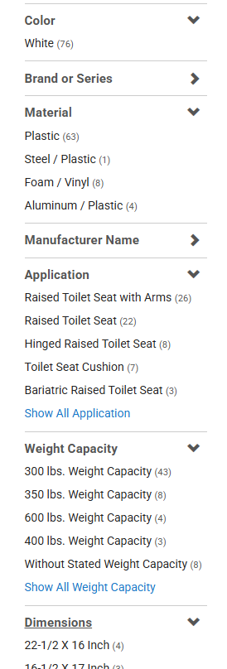
Customer Experience: On the product category page, could the sidebar be changed to a filter panel that allows customers to refine products by use case, material, size, wound type suitability, etc.?
This would make it easier for customers to find the most suitable products. (Currently, the sidebar retains the same categorization as the parent page.)

Slide 4
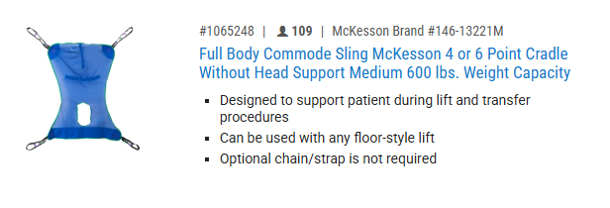
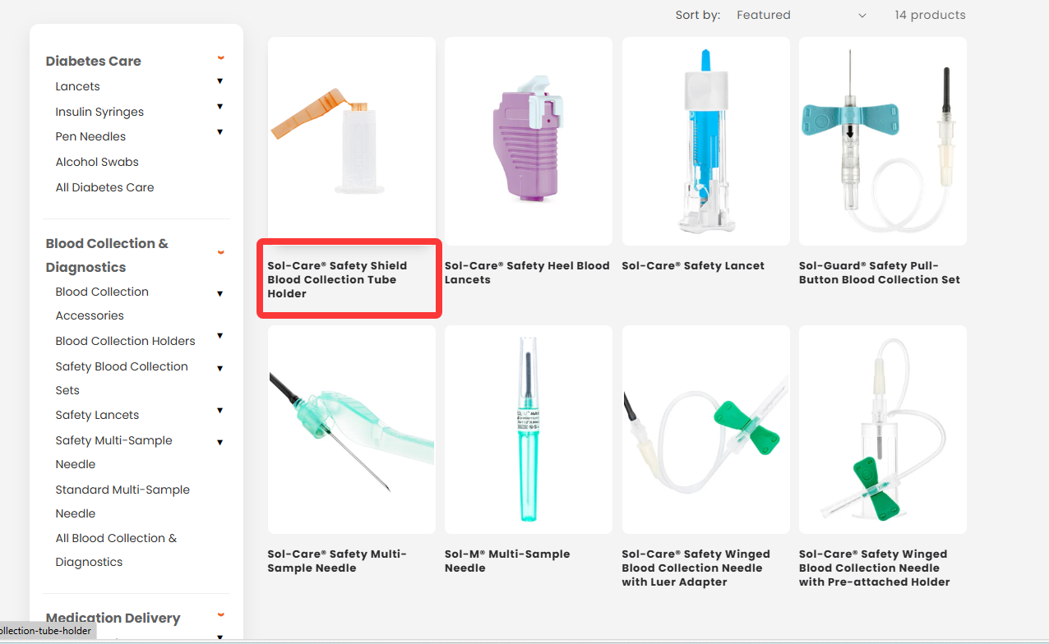
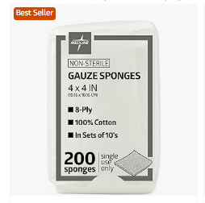
Customer Experience: currently, the number of SKUs within each product category is limited, and only the main product image and name are displayed. Consider enhancing the category listing page by adding up to three bullet points to highlight key features or benefits of each product.
Additionally, if any Business Unit (BU) has products they want to prioritize or promote, a "Bestseller" or "Hot Selling" badge could be added to those items within the category to attract user attention and encourage clicks and inquiries.

Slide 5
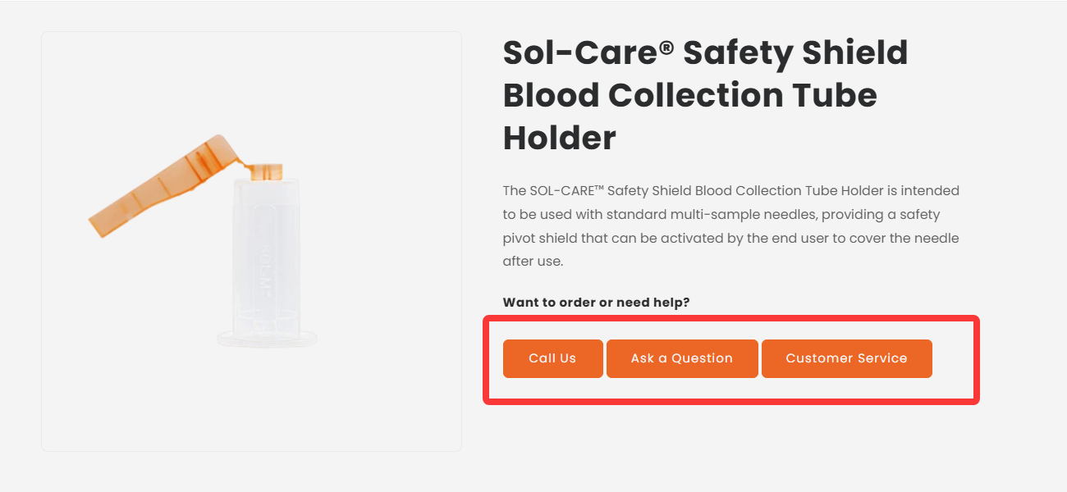
Customer Experience: On the PDP page, the customer’s call-to-action (CTA) could be more focused. Since this is primarily a B2B e-commerce website, key CTAs could include:
“Add to Cart”
“Ask a Sol M Expert” (for pricing inquiries)
Customer Service Button could be low priority (already clearly visible at the top of the page)
Add to cart
Ask a Sol M expert （either phone number or webform）

Slide 6
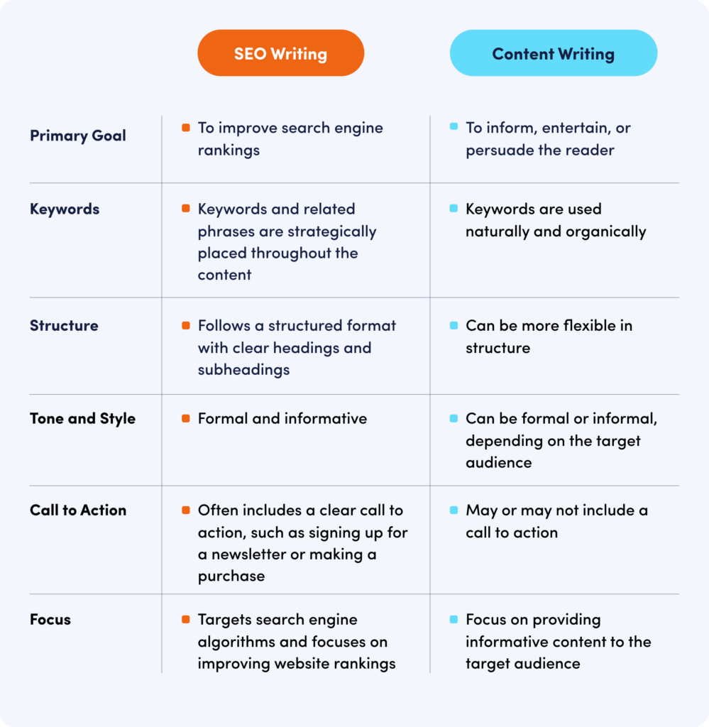
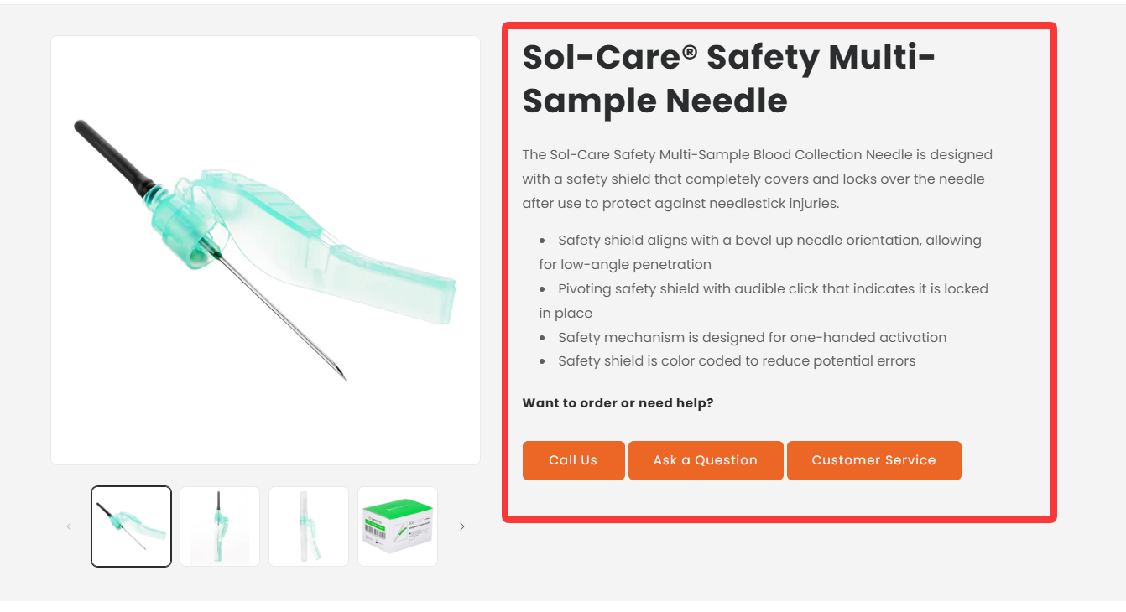
Content Optimization: To support SEO efforts, could you provide product managers with a guideline for crafting content and incorporating relevant keywords on PDP Page templates. This may help increase the visibility and searchability of product pages.

